Slide 1

General DisArrays Project Report 1 Team Leader: Jon Mauriala Team Member: Ty Gregory Team Member: Robert Colvin
CSCI363: User Interface Design
Fall 2024 Semester
10/05/2024

Slide 2
Collaboration 9/29
Logo created by Ty Gregory
Integrated into PowerPoint by Jon Mauriala
Reviewed Logo and opening slide for PowerPoint presentation
Ty Gregory Setup GitHub Repository
Using Discord for collaboration and communication
Scheduled next meeting for 10/06

Slide 3
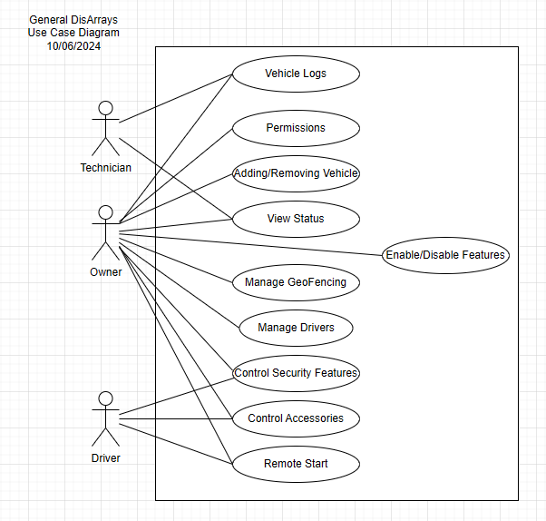

Slide 4
Collaboration 10/06
Implemented Use Case model in Draw.io and Robert Colvin hosted on Google Drive to allow for rapid communication
Scheduled next meeting for 10/06

Slide 5
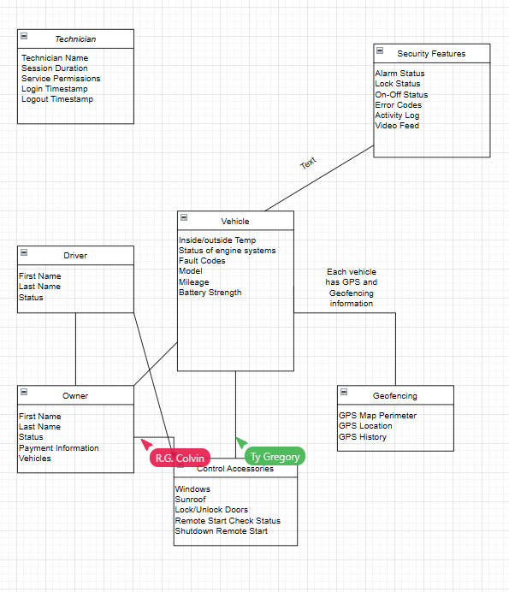

Slide 6
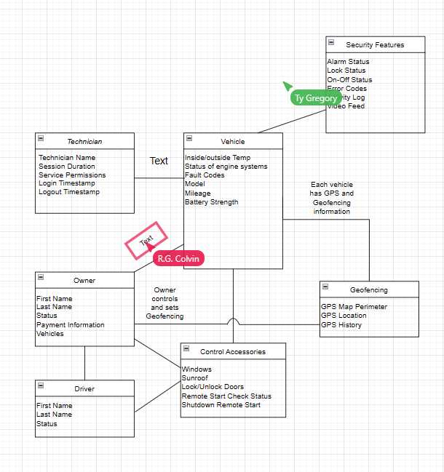

Slide 7
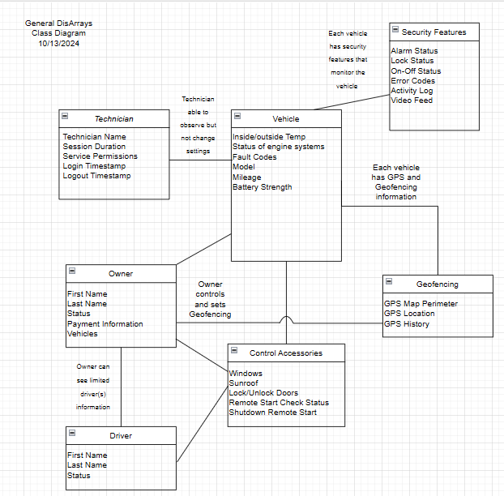

Slide 8
Collaboration 10/13
Implemented Class model in Draw.io and Robert Colvin hosted again on Google Drive to allow for rapid communication
Decided to add notes on lines between classes to clarify relationships if needed
Combined aspects of the Use Diagram in the Class model
Sent email to customer (Prof Grant) for clarification on Interface Drawing requirements
Scheduled next meeting for 10/20

Slide 9
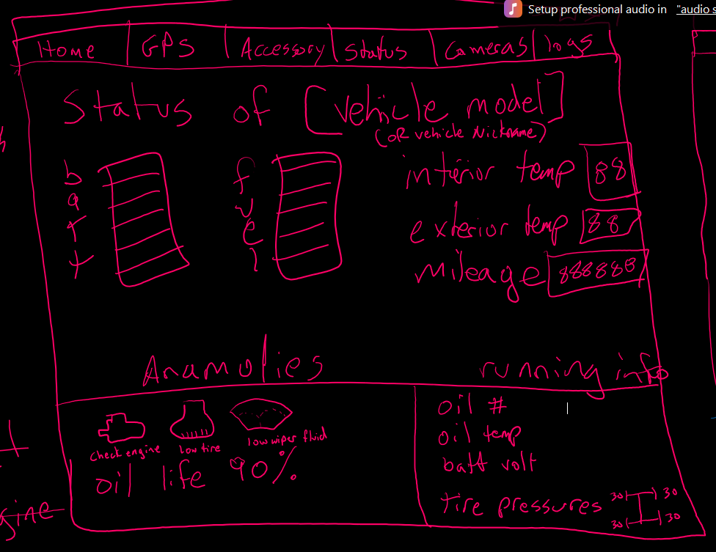

Slide 10
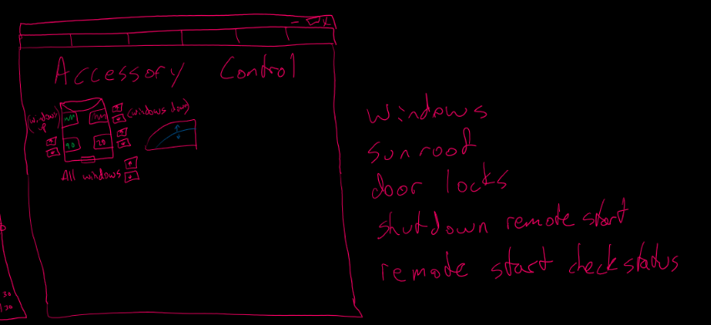

Slide 11
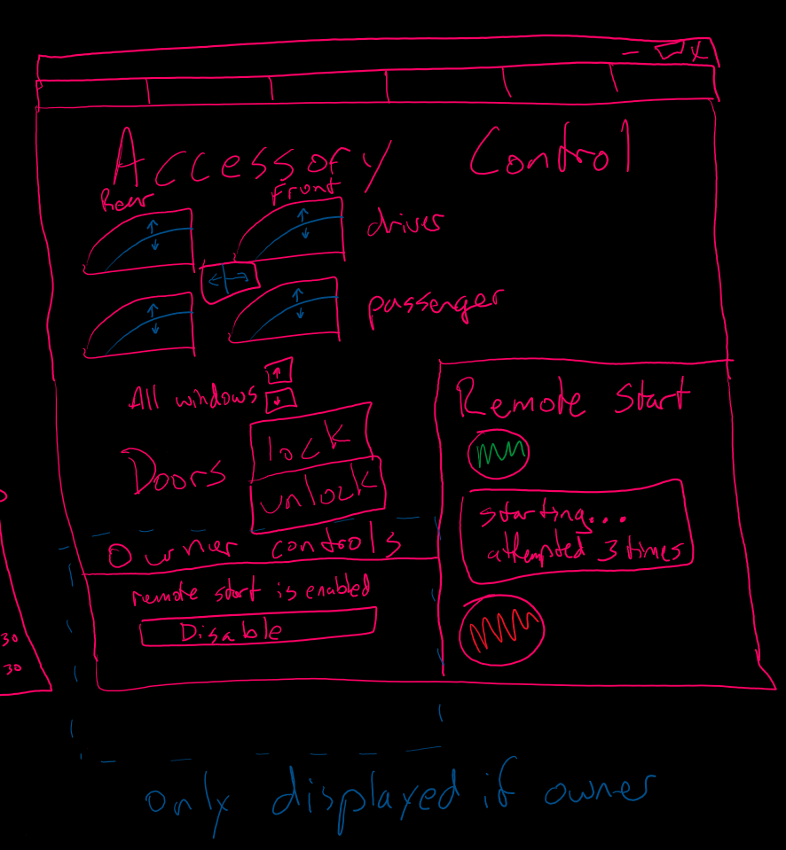

Slide 12
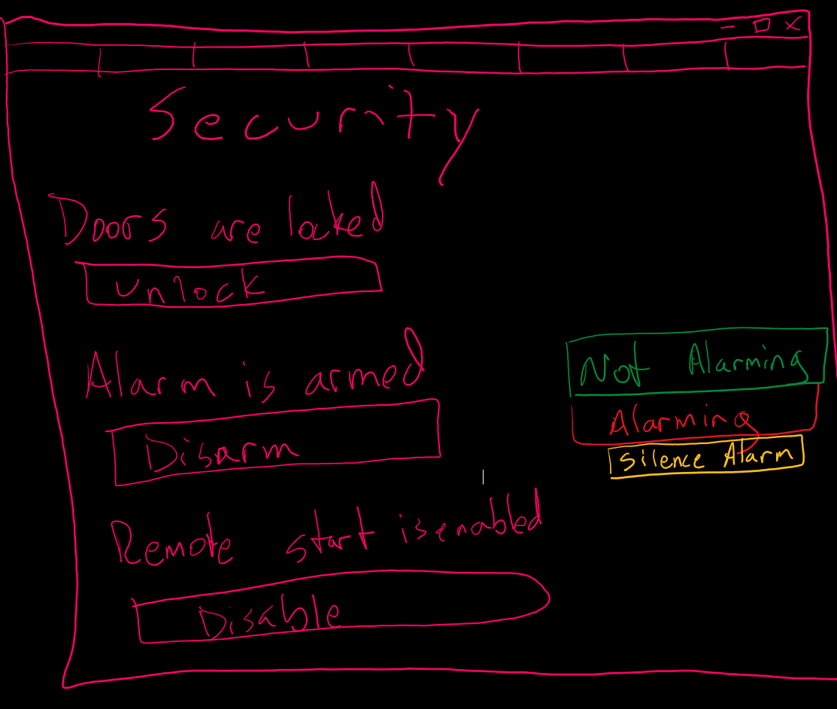

Slide 13
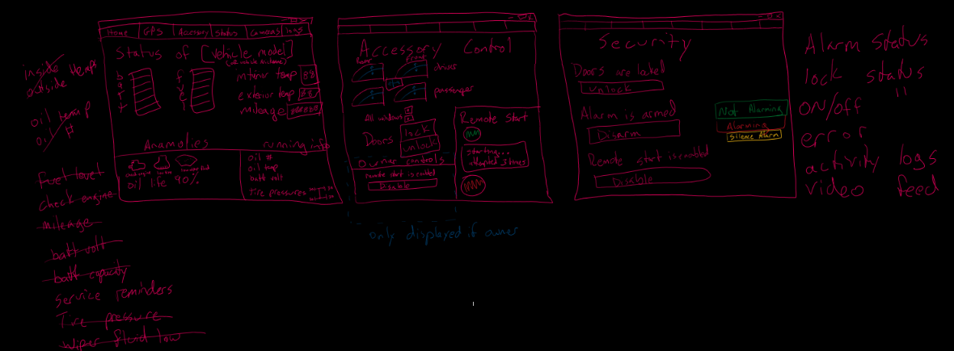

Slide 14
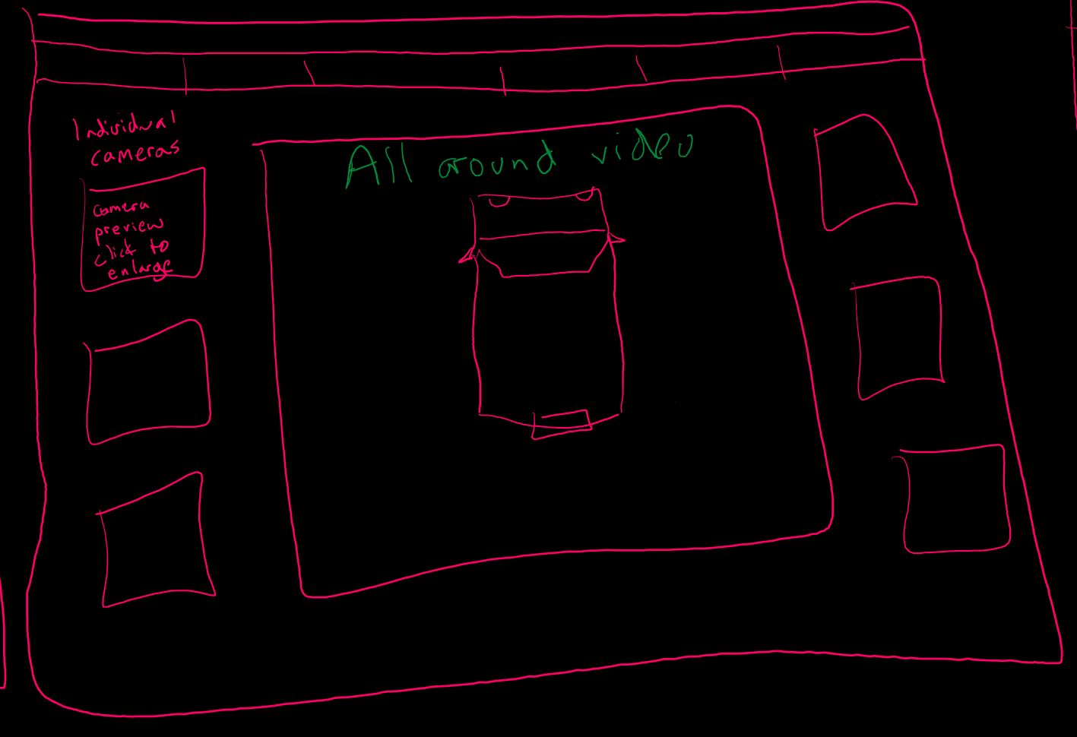

Slide 15
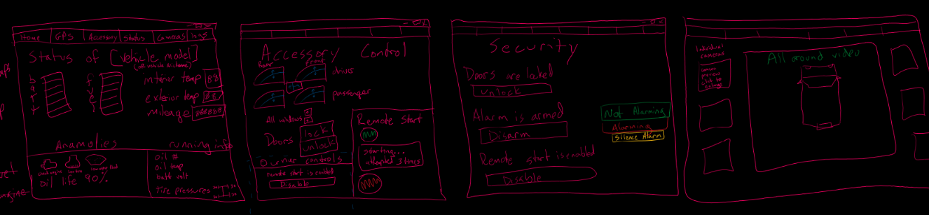

Slide 16
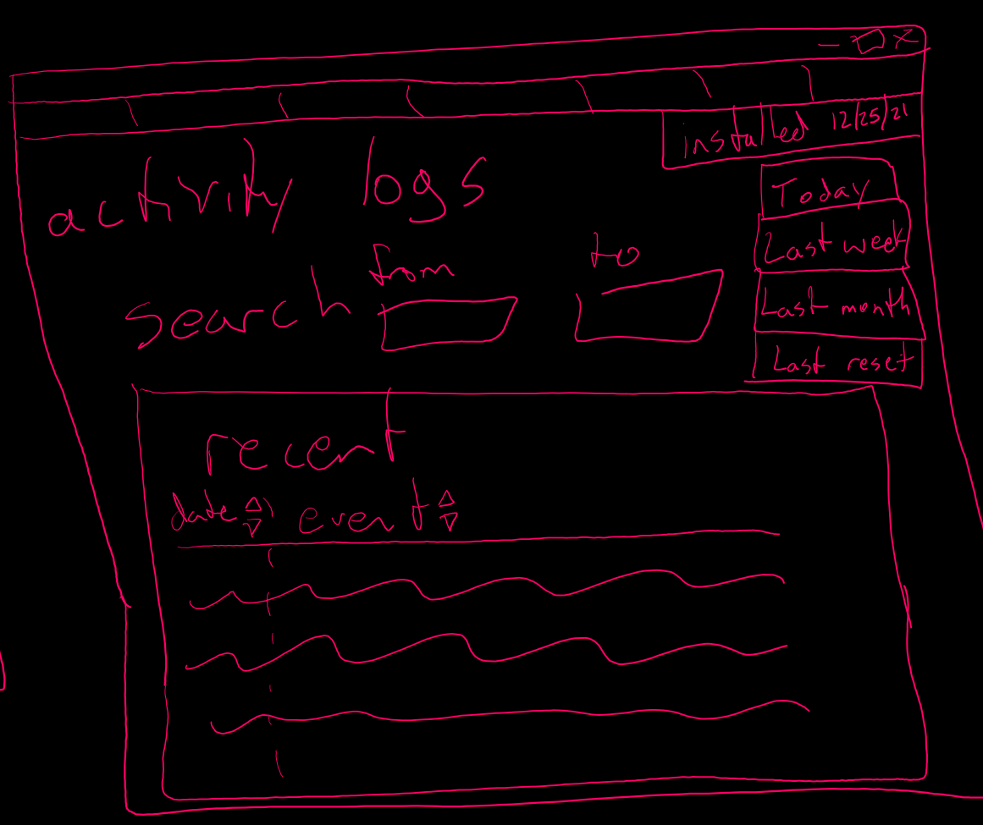

Slide 17
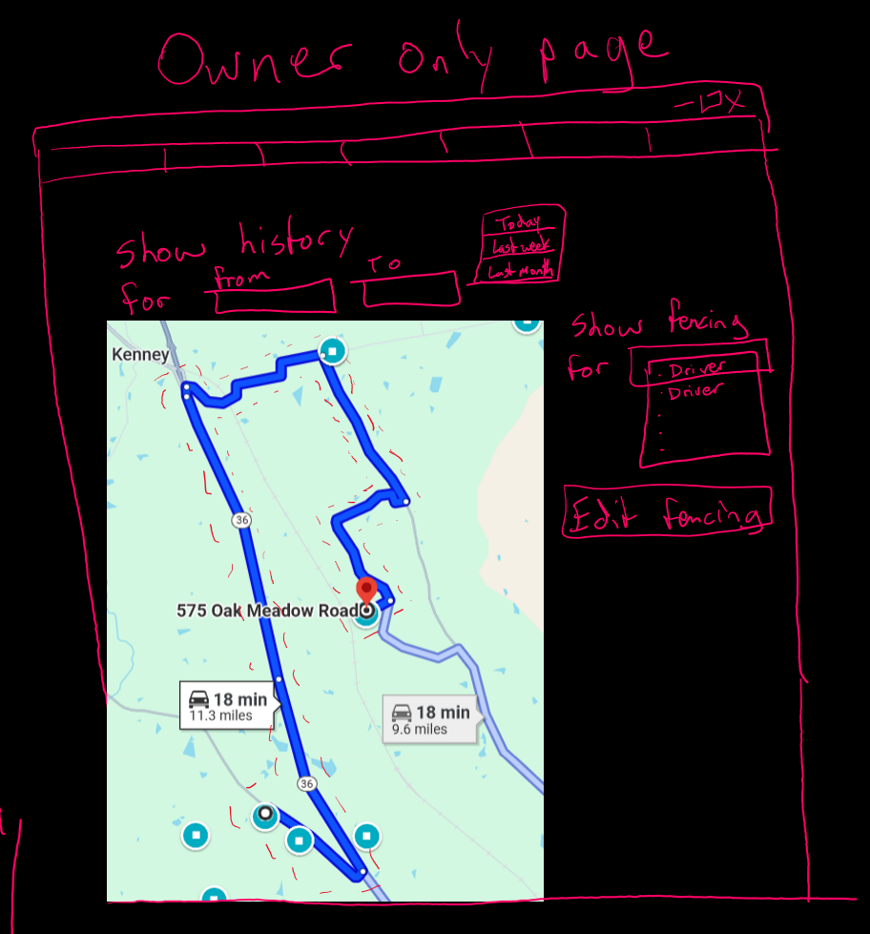

Slide 18
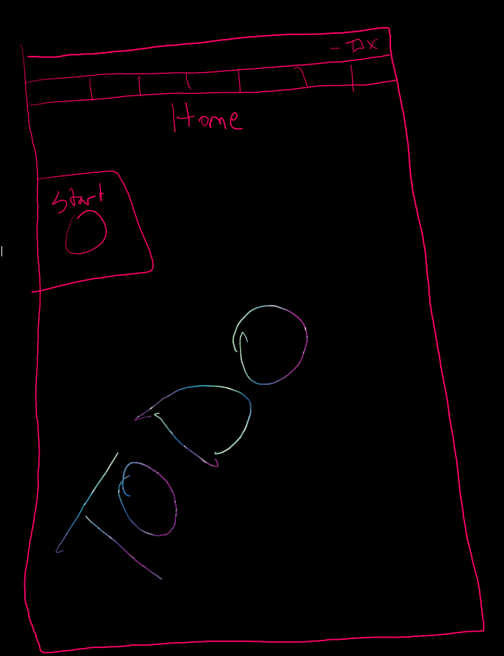

Slide 19
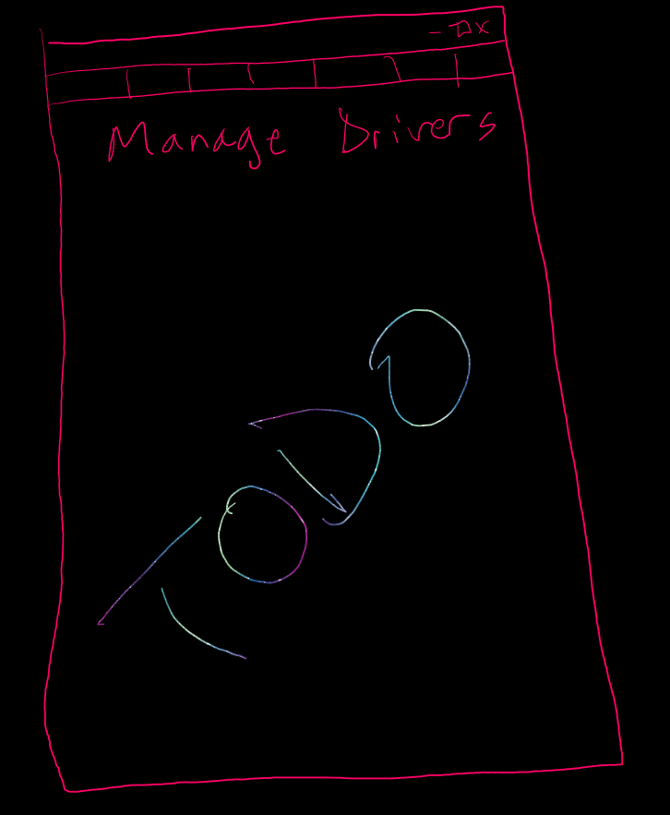

Slide 20
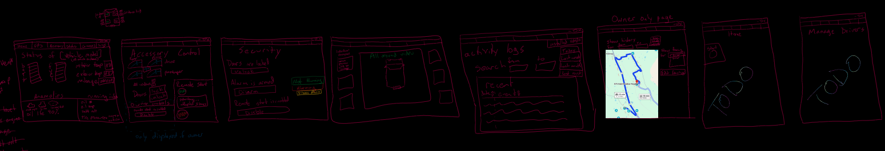

Slide 23
Collaboration 10/21
Verified the interface drawing to be wireframing without screen connections
Started with end pages and build backwards to menu screen to drive modularity and separation of concerns
Using touchscreen with pen for mock-up
Decided to list mileage twice, in the log and status screens
Windows/desktop monitor-based app. Placing the navigation tools at the top of the window which would be persistent across all pages for consistency of experience

Slide 24
Collaboration 10/21
For status page, listing the running information and a warning
Opted to list the battery and fuel, if a hybrid it will list both
Track the anomalies in the log/journal?
Green or red for showing window up or down? Using in conjunction with % to reflect the information both ways.
Changed to showing windows from the side instead
After discussion it was decided to hold off on adding a trunk lock/unlock feature
Decided to put the video log in the log screen

Slide 25
Collaboration 10/21
Using red dotted line to show geofencing on the GPS screen
Scheduled next call for 10/23 to conclude Phase 1 report out
Home Screen
Manage Drivers
Technician Screen

